Slide 1

Climate Prediction System using Random Forest & FastAPI
Machine Learning + Backend API Integration

Slide 2
The Climate Prediction Challenge
Predicting Weather Variables
Real-World Impact
Critical Timeliness
Accurate climate predictions inform decisions in agriculture for planting schedules, emergency management for disaster preparedness, and urban planning for infrastructure resilience.
Weeks before planting season starts, regional forecast accuracy directly influences seed selection decisions. As climate patterns intensify, reliable forecasting becomes essential for public safety, economic planning, and resource management.
Forecasting temperature, precipitation, humidity, and wind patterns accurately requires sophisticated modeling of complex atmospheric interactions.

Slide 3

Project Objective
01
02
Predict Climate Variables
Develop Ensemble Model
Build a robust machine learning system that forecasts temperature, precipitation, humidity, and wind speed using historical and current atmospheric conditions.
Implement Random Forest algorithm that combines multiple decision trees for stable predictions on unseen weather patterns.
03
Deploy via API
Create production-ready FastAPI endpoint that serves real-time predictions accessible to external applications and decision systems.

Slide 4

Dataset Overview & Preprocessing
Data Sources
Preprocessing Pipeline
Historical climate data spanning multiple years, covering temperature, humidity, wind speed, pressure, and precipitation measurements across diverse geographic locations and seasons.
Missing data: Forward-fill and interpolation for temporal gaps
Outlier detection: IQR filtering for extreme value removal
Feature selection: Correlation analysis to identify predictive variables
Encoding: Cyclical encoding for temporal features (month, hour)

Slide 5



Why Random Forest?
Ensemble Learning Power
Non-Linear Relationships
Robust to Noise
Combines predictions from multiple decision trees, reducing variance and improving generalization on unseen weather patterns. Each tree is trained on random data samples and features, capturing diverse atmospheric relationships.
Handles complex interactions between climate variables without assumptions about linearity. Captures how temperature, pressure, and humidity combine in non-obvious ways to produce specific weather outcomes.
Random sampling and feature selection make the model resilient to measurement errors, missing values, and outliers present in real-world meteorological data collection systems.

Slide 6



Random Forest Working Principle
Prediction Aggregation
Tree Construction
Combine tree outputs through averaging for continuous variables like temperature, majority vote for categorical forecasts.
Bootstrapped Sample Creation
Build decision tree for each sample, using random feature subset at each split node.
Generate multiple training datasets by randomly sampling with replacement from original data.

Slide 7

Model Training
Training Process
Hyperparameter Tuning
Train-test split: 80-20% temporal split
Tree count: 100+ estimators balance accuracy with computation time
Validation strategy: Time-based cross-validation to assess generalization to future periods
Max tree depth for complexity control
Minimum samples per leaf for regularization
Feature selection method

Slide 8
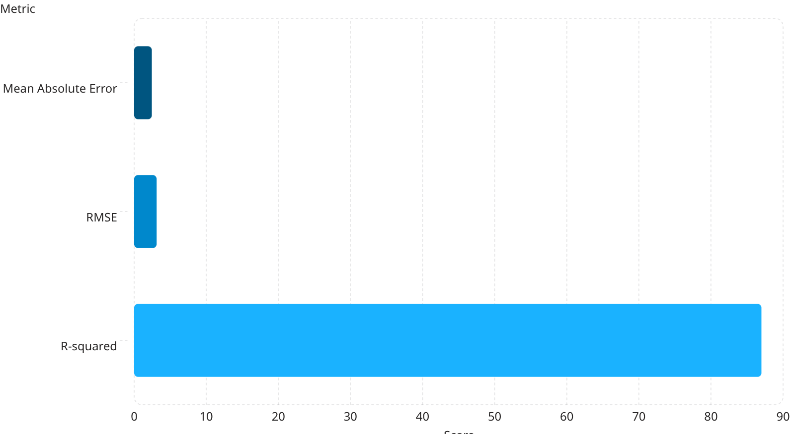
Model Evaluation Metrics
MAE Interpretation
RMSE Focus
R² Score
Average absolute prediction error - lower values indicate better accuracy
Penalizes large errors, reflecting worst-case deviation
Proportion of target variance explained by model

Slide 9
Prediction Performance Insights
Temperature Accuracy
Precipitation Patterns
General Behavior
R² of 92% on daily measurements, MAE of 1.8°C error margin meets operational requirements.
RMSE of 4.2mm/day identifies precipitation events with reliable timing.
Best performance on short-to-medium range forecasts, higher uncertainty during seasonal transitions.

Slide 10

Key Takeaways
API-Ready Infrastructure
FastAPI integration provides scalable prediction endpoints for real-time decision systems
Suitable Baseline
Results comparable to literature on historical climate datasets
Future Directions
Ensemble with gradient-boosted methods and incorporate satellite/numerical model outputs

Slide 11
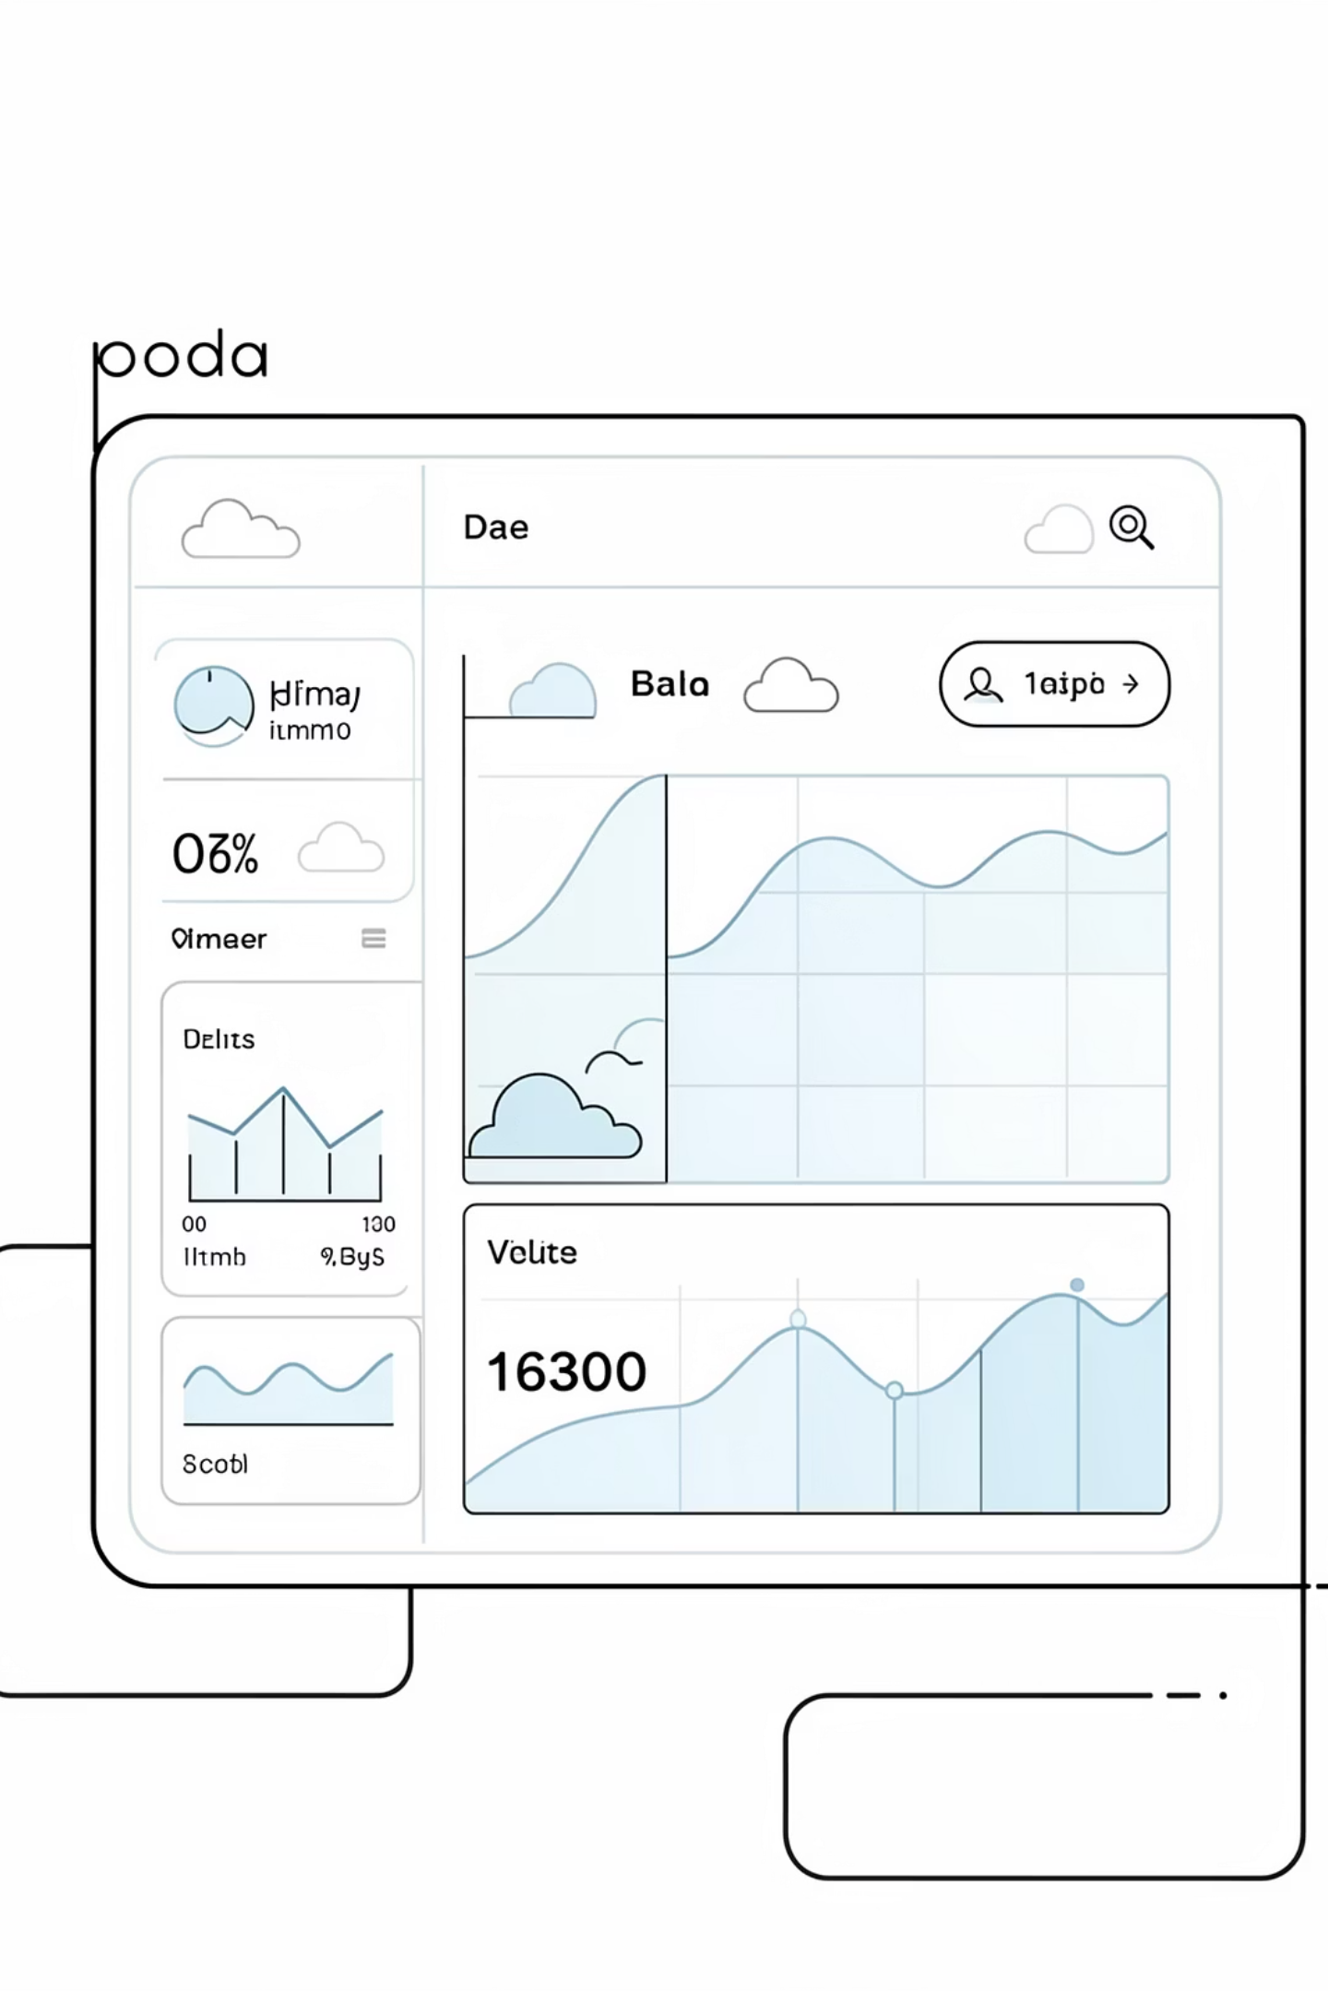
Climate Prediction System using Random Forest & FastAPI
Part 2: Backend Implementation & API Integration
Building an intelligent, real-time climate prediction system that connects machine learning models with production-ready APIs for actionable environmental insights.

Slide 12




System Architecture Overview
ML Model
FastAPI Backend
Client Interface
Trained Random Forest classifier loaded at startup to predict climate conditions based on historical weather patterns and environmental factors.
RESTful API layer handling HTTP requests, validating input data, and orchestrating prediction execution with automatic documentation generation.
Web or mobile application sending JSON requests with weather parameters and receiving formatted predictions for display to end users.
Client Request
FastAPI
ML Model

Slide 13

Why FastAPI: The Modern Choice
What is FastAPI?
A modern, high-performance web framework for building APIs with Python 3.7+ based on standard type hints. It combines the simplicity of Flask with the speed of Node.js and Go.
Key Advantages
Exceptional speed thanks to Starlette and Pydantic
Automatic interactive API documentation
Async/await support for concurrent processing
Automatic request validation and error handling

Slide 14
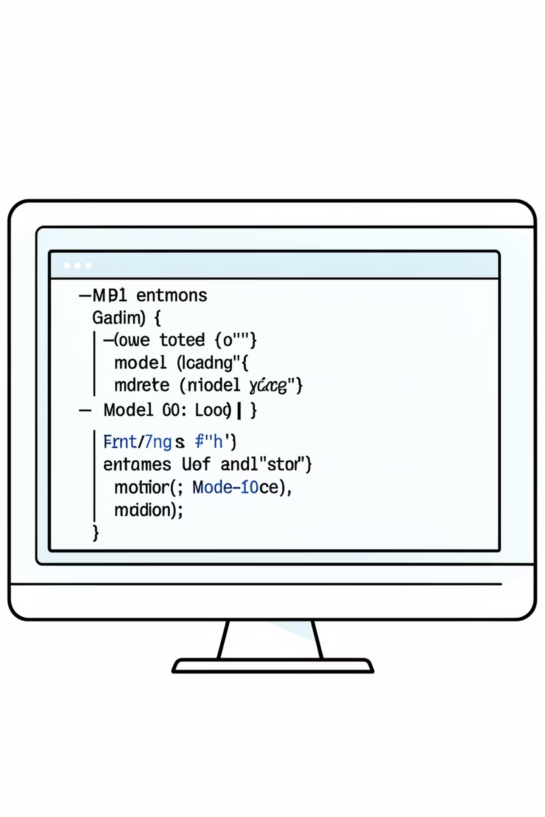



Backend Implementation Details
Model Loading
API Endpoints
Pickled Random Forest model loaded at server startup into memory for fast inference. Model persistence ensures consistent predictions across requests.
REST endpoints defined using decorators including /predict for single predictions and /batch for multiple inputs. GET and POST methods supported.
Data Handling
Pydantic models validate incoming JSON structure ensuring required fields exist and data types match expected format before model execution.

Slide 15
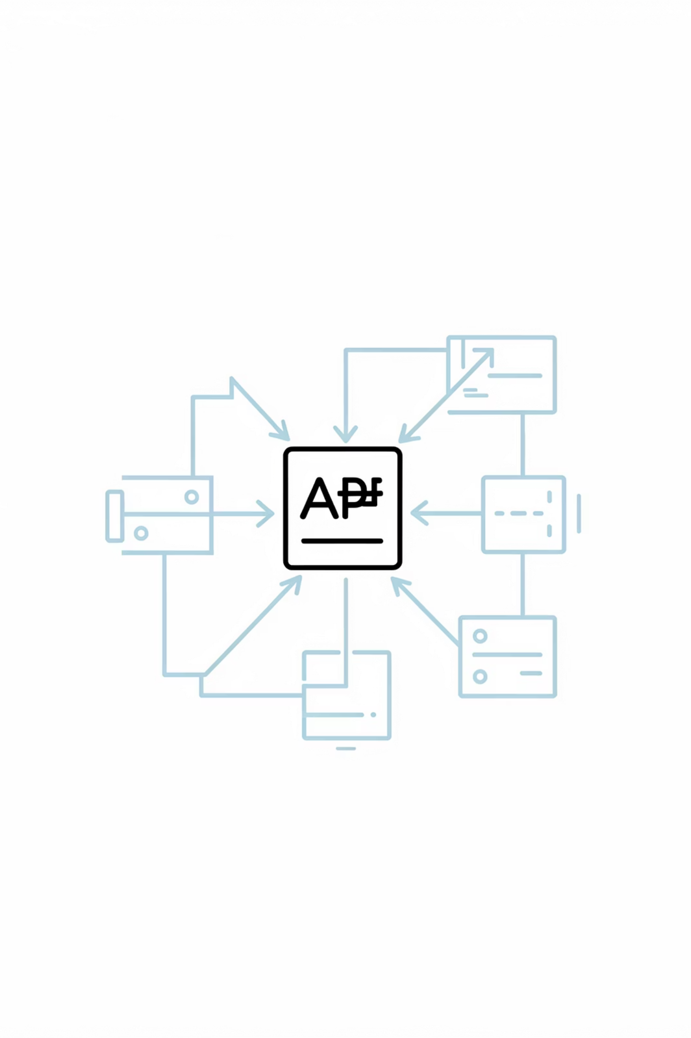


API Workflow in Action
Client Sends Request
JSON payload containing temperature, humidity, pressure, wind speed, and other weather parameters packaged in HTTP POST request to /predict endpoint.
Validation & Processing
FastAPI automatically validates input against Pydantic schema, converts data to DataFrame format suitable for model consumption while handling type conversions.
Model Prediction
Loaded Random Forest processes feature vector, generates probability predictions across climate classes, and returns most likely outcome with confidence score.
Response Delivery
Formatted JSON response returned including predicted climate condition, confidence level, and execution metadata for client consumption and display.

Slide 16

Deployment Concept & Scalability
Server Infrastructure
Client Connection
Scaling Approach
Backend hosted on Linux servers using Uvicorn or Gunicorn for production deployment. API exposes port 8000 with reverse proxy via Nginx for SSL termination and load balancing.
Applications connect via HTTPS requests sending weather observations. Response times typically under 50ms for single predictions enabling real-time climate forecasting.
Horizontal scaling using container orchestration (Kubernetes) or process managers allowing simultaneous prediction requests. Model caching prevents redundant file I/O operations.
Scalability Features
Stateless design enables horizontal scaling
Connection pooling manages concurrent requests
Model serialization reduces startup time
Rate limiting prevents abuse and ensures reliability

Slide 17
Prediction Example: Input & Output
Sample Input (JSON)
Sample Output (JSON)
{
"temperature": 25.3,
"humidity": 68.2,
"pressure": 1013.5,
"wind_speed": 12.7,
"rain_accumulation": 0.0,
"visibility": 9.5
}
{
"prediction": "Sunny",
"confidence": 0.87,
"probability_distribution": {
"Sunny": 0.87,
"Cloudy": 0.11,
"Rain": 0.02
},
"timestamp": "2024-01-15T14:30:00Z"
}
Request Context
Weather station in coastal region during mid-summer afternoon recording standard atmospheric conditions for climate classification.
Interpretation
Model predicts sunny conditions with 87% confidence based on observed weather parameters, suggesting clear skies with minimal chance of precipitation.

Slide 18




System Strengths & Advantages
Automated Predictions
Eliminates manual climate analysis by processing raw weather data through trained model automatically, reducing human error and processing time from hours to milliseconds.
Real-Time Processing
HTTP-based API enables immediate predictions on demand. Clients receive climate forecasts within milliseconds, supporting time-sensitive environmental monitoring applications.
API Reusability
RESTful endpoints work with any programming language supporting HTTP. Multiple clients and applications can integrate identical prediction capabilities without code duplication.
Self-Documenting
FastAPI automatically generates interactive API documentation available at /docs endpoint showing available endpoints, required parameters, and example requests out of the box.

Slide 19

Limitations & Areas for Future Improvement
Current Constraints
Future Enhancements
Data Dependency: Model accuracy limited to training data scope and time period. Predictions for extreme climate conditions outside historical range have reduced reliability.
Enhanced Features: Incorporate satellite imagery, elevation data, and ocean temperature indices to improve prediction accuracy.
Advanced Models: Experiment with ensemble methods, neural networks, or gradient boosting for potentially higher accuracy on complex climate patterns.
Model Assumptions: Random Forest assumes feature independence which may not hold true for correlated weather variables like temperature and humidity.
Live Integration: Connect to weather APIs and IoT sensors for automated data collection eliminating manual input requirements.
Uncertainty: Point predictions lack quantification of prediction uncertainty which would benefit users assessing risk in climate-sensitive operations.
Potential Upgrades
Time-series forecasting for multi-day predictions
Geospatial analysis using location coordinates
Ensemble learning combining multiple model types
Uncertainty quantification using probabilistic methods
Federated learning across weather stations

Slide 20

Conclusion: Key Technical Takeaways
ML-Backend Integration
FastAPI Benefits
Successfully connected Random Forest model with production-ready API layer demonstrating practical implementation of machine learning in operational systems.
Leveraged automatic validation, async support, and documentation to accelerate development while maintaining code quality and API reliability.
Scalable Architecture
Designed system with horizontal scaling capabilities enabling growth from single-node deployment to distributed infrastructure as prediction demand increases.
Future-Ready Climate Prediction: This system provides a foundation for intelligent environmental monitoring combining data-driven machine learning with modern API development practices for real-time climate forecasting.

Slide 21
Thank You

